Slide 1
Boilers: Watch Out!
By: Team Skyhawk

Slide 2
What’s the problem here?
Notes:
We’re tackling a quality of life problem - you move into a new apartment, your heat no longer works, and the temperature drops overnight. You’re entirely reliant on the landlord fixing your boiler and getting your heat working.

Slide 3
Landlords don’t fix their boilers!
Notes:
And this is also a safety issue. In extreme cases, boilers can explode, injuring or killing tenants.

Slide 4
So tenants call 311 to get their boilers inspected...
Notes:
Before you file an official 311 complaint with the NYC Department of Buildings (DOB), you complain to your landlord and hope they solve the problem. If they don't honor your request or otherwise fail to respond, a 311 call can get the Department of Housing Preservation and Development involved. The HPD may come to the building and stick your landlord with a costly violation (last year, HPD inspectors wrote 4,755 heat violations, an increase of 36 percent from the prior year).
Ref: https://www.brickunderground.com/blog/2014/10/heating_101

Slide 5
Only 30% of inspections result in a violation.
Notes:
70% of all inspections to all 311 complaints determine no further action is necessary.

Slide 6
Less than 25% complaints overall are resolved within a week.

Slide 7
Solution!
Build a model that can prioritize pending boiler complaints.
Optimize boiler inspections to save time and money and resolve dangerous situations faster.
Notes:
We are developing a classification model to optimize how which inspections are prioritized. We want the city to more quickly respond to complaints that will most likely result in a violation.
We want to develop a tool that, given a building in NYC, can:
Return a classification on whether or not boiler will yield a violation. We will score this to prioritize complaints.
Save the city man hours and money by identifying these potential high risk violation locations (let’s inspect complaints where they will find issues!)
In other words, given a 311 boiler complaint, we want to give a yes or no answer if this will result in a violation and if we should prioritize it.
We’re focusing on boilers for this exercise initially, but we believe our process can generalize to any building violations.

Slide 8
Assumptions
There are not enough resources to carry out inspections in a timely fashion.
Inspections not resulting in violations implies there were no defects with the boiler.
The number of complaints a building receives speaks to the quality of the building/management.

Slide 9
Feature Selection
Features:
Boiler features: make, age, model
Building features: prior complaints, tax assessment
Boiler complaint type
Notes:
We are interested in:
Quantity of boiler complaints & resolution type
Features of buildings with boiler violations
Extrapolate features of neighborhoods with boiler violations

Slide 10
Dataset Selection
DOB Safety Boiler
BIN
Boiler features
DOB Violations
BIN
Type (boiler related)
Category (active, dismissed, ect.)
DOB Complaints
BIN
Dispositions (resolution)
Category (boiler related)
Notes:
We are interested in:
Quantity of boiler complaints & resolution type
Features of buildings with boiler violations
Extrapolate features of neighborhoods with boiler violations

Slide 11
Plan
Finalize features from datasets
Train Random Forest
Publish results and models
Blow the lid off this thing!

Slide 12
Spread the Word

Slide 13
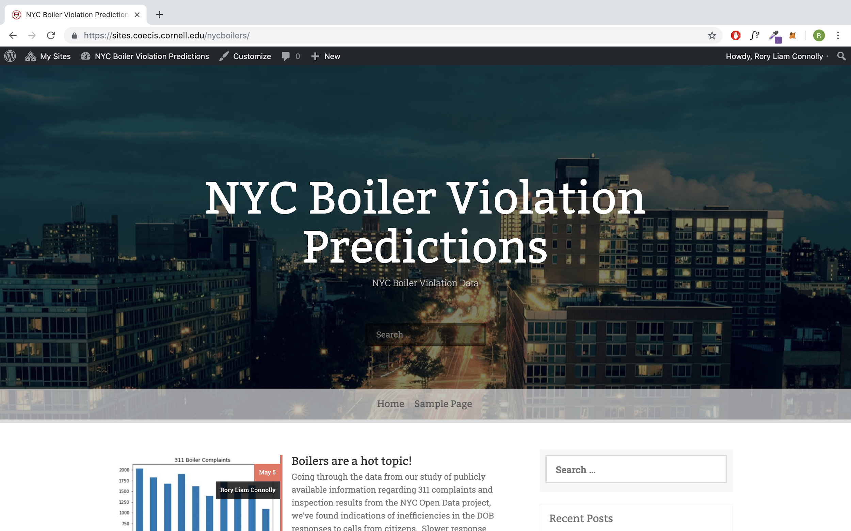
Publishing our Results
We are putting our results up on the internet and will be linking to official NYC accounts through social media to enact change!

Slide 14
Appendix

Slide 15
Reporting Procedures
The Department of Buildings (DOB) requires an annual boiler inspection report before the end of each calendar year for:
Buildings occupied by 6 or more families
Boilers located in commercial or mixed-use buildings
Boilers over 350,000 BTU
Annual boiler inspection reports are submitted by a licensed professional in the DOB NOW: Safety portal.
Notes:
Ref: https://www1.nyc.gov/nyc-resources/service/1218/boiler-inspections

Slide 16
Ethical considerations
Given we are prioritizing which boilers are inspected, it is possible that we under-prioritize a boiler which truly needs attention. This can be a safety issue.
Notes:
Ref: https://www1.nyc.gov/nyc-resources/service/1218/boiler-inspections

Slide 17
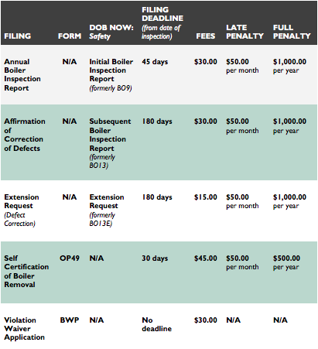
Fee Breakdown
Notes:
Ref: https://www1.nyc.gov/assets/buildings/pdf/boilers-guide-english.pdf

